Slide 1
IBO
Toolbox
Presented by Jenny Fletcher
A business network for Internet marketers
Notes:
Today I am presenting the networking site IBO Toolbox which you will find very useful in addition to Facebook for finding new people to add to your business

Slide 2
IBO Toolbox - Overview
IBO Toolbox is actually a set of related websites:
IBO Toolbox - business network
IBO Social - where your profile is stored
IBO Tube - Video site
IBO Gigs - Advertise skills, find small paid tasks
IBO Exchange - a form of Traffic Exchange
In this presentation - ‘IBO Toolbox’ will refer to the combination of Toolbox+Social as they are closely linked in usage. The other sites will not be a part of the presentation
Notes:
So, what is IBO Toolbox and how do you start to use it - first you need to understand the structure - not one site but several

Slide 3
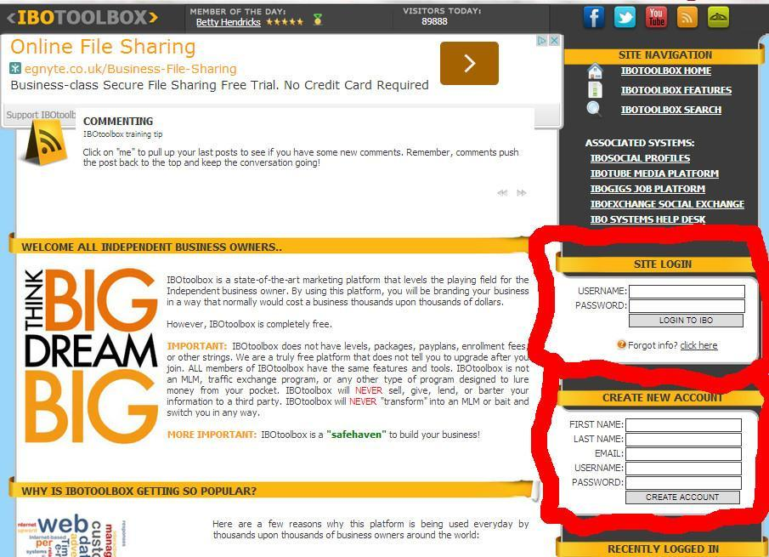
IBO Toolbox - Home page
This is where
you login
and start to
create your
new account
Login here
Create a new
account
here
Notes:
This is where you get started

Slide 4
IBO Toolbox Menu
This is the main navigation menu for all the things you will want to do. To view your own profile click your name at the top of the page
To edit your profile - click the menu item top right
Notes:
This is the menu you will use most often to get around the site

Slide 5
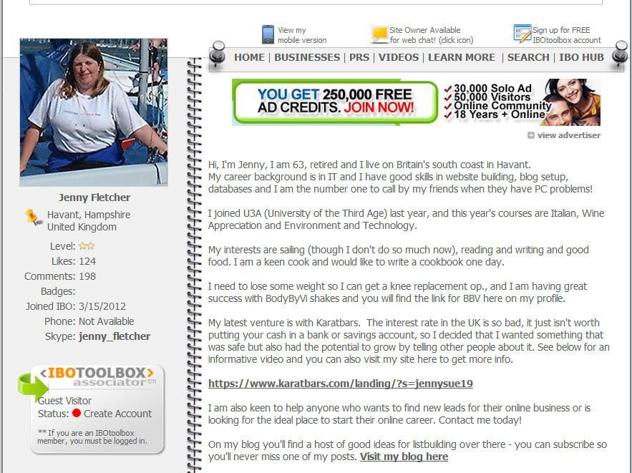
Your IBO profile
Welcome to my
IBO social profile
You will see that there is another navigation menu at the top of your profile page
Notes:
Your profile lives on IBO Social which has its own menu

Slide 6
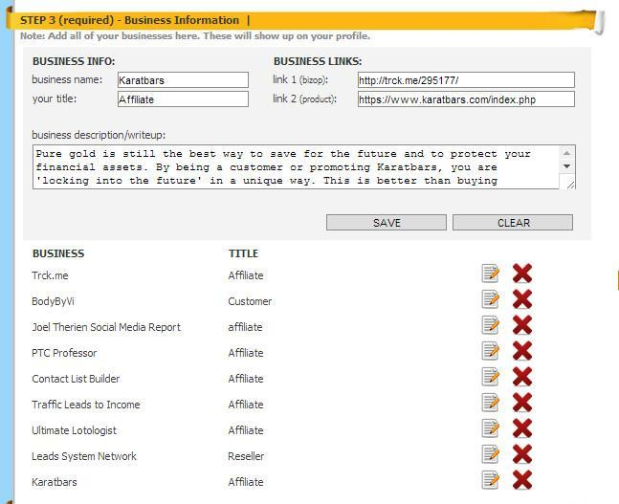
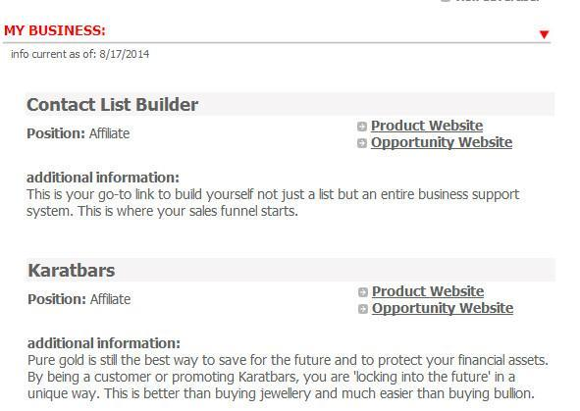
List your businesses
Create the list using Edit Profile from the main
Toolbox Menu - scroll down the edit page to see
where to list your businesses
This is how my business activities display in my IBO Social profile

Slide 7
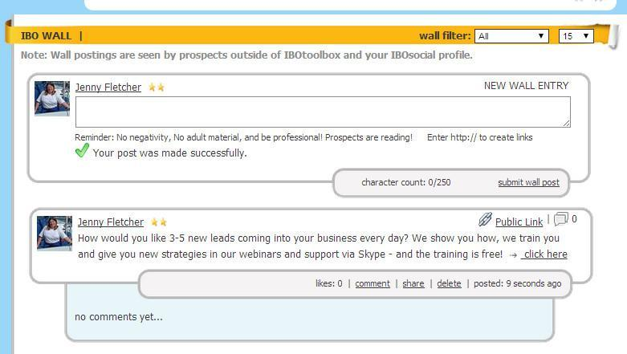
Welcome to the IBO Wall
This is one place where you will find new associates and bring them into your group

Slide 8
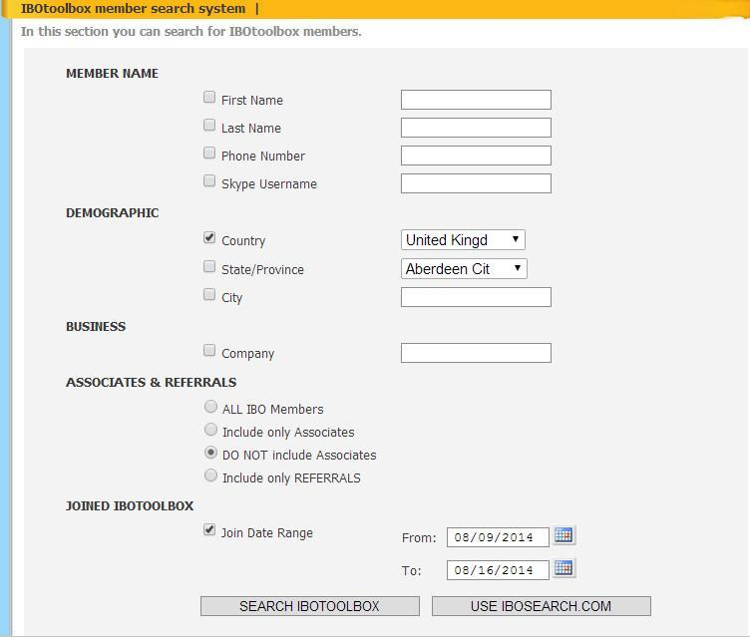
IBO Search
You can also search for
new associates
using filters :
Step 1. Select your filters - here I am looking for UK members who have joined recently
so I set UK in the country box and check that item
I only want people who are not already my associates and I also set a date range

Slide 9
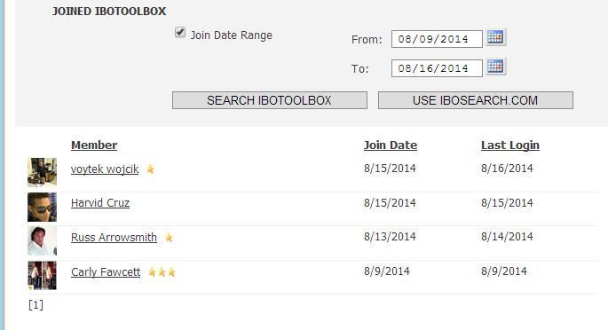
IBO Search
Search for new associates using filters :
Step 2. Select the members you would like to be associates by clicking their names
- a popup window will open

Slide 10
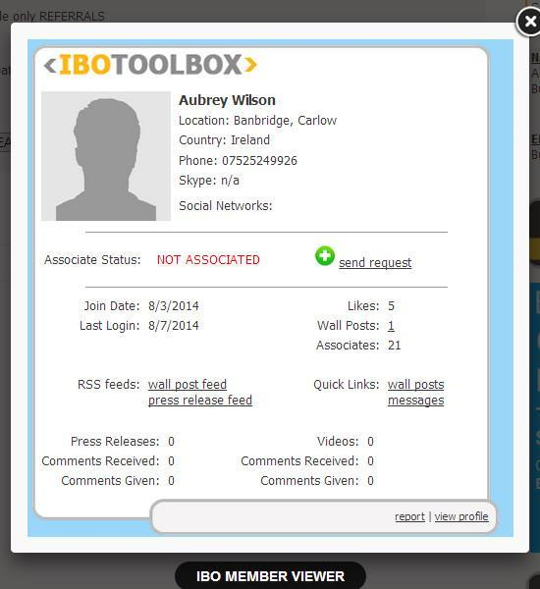
IBO Search
Search for new associates using filters :
request the
member to be your associate
here
Step 3.
You can view a profile from the pop-up member box
and it will open
a new window
view the
member’s
profile
here

Slide 11
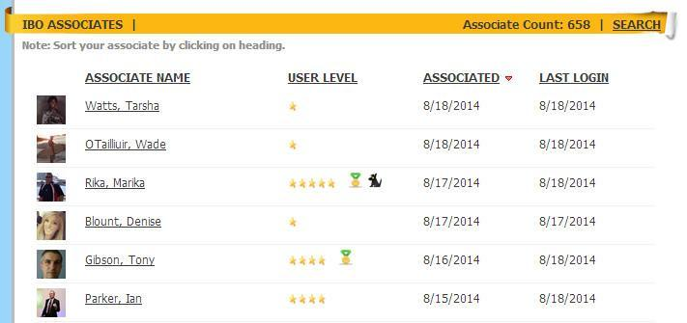
Your IBO Associates
Your IBO associates list is selected from the Toolbox menu
Members can invite you to be an associate and the icon appears above the menu - click on it or go to the associates list to accept

Slide 12
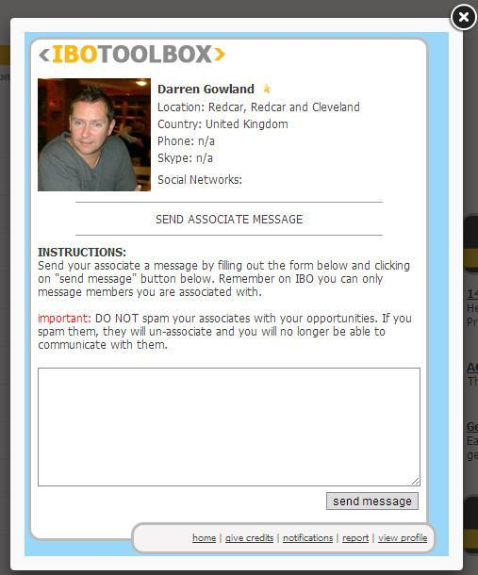
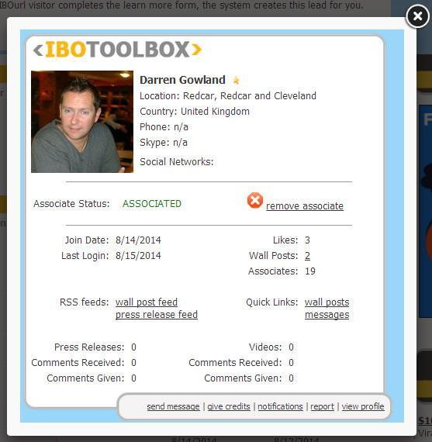
Send a message to an associate
Select associate from list by clicking on name to get the popup box then click
‘Send Message’ - observe the rules!
Send your message
send a
message
here

Slide 13
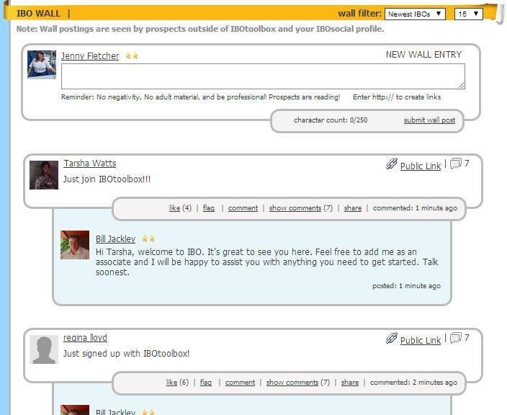
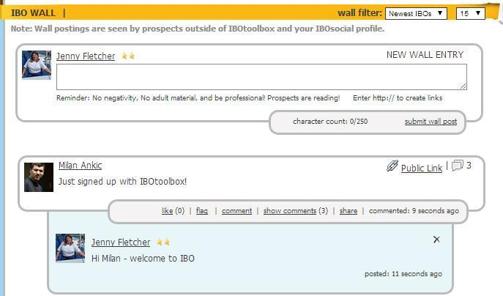
Find New IBO members on the wall
Click ‘newest IBO’ on the drop down list’
Send an associate request by clicking on their name and/or send them a welcome message by clicking ‘comment’

Slide 14
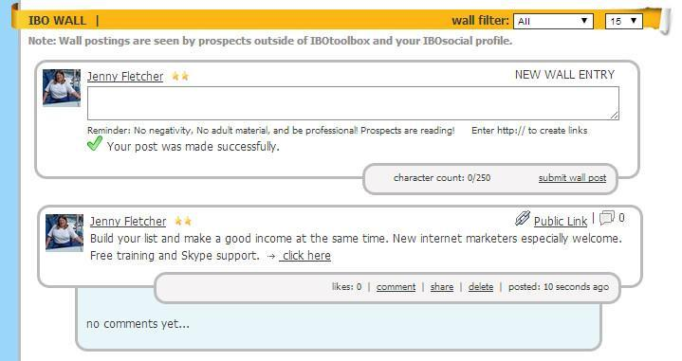
Invite IBO members to visit your site
Use the wall to create an invite to your lead capture page with a link - links always appear as ‘click here’

Slide 15
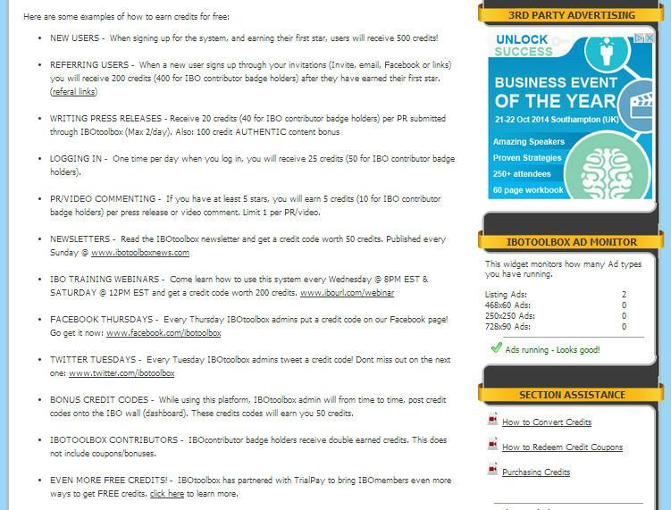
IBO Advertising
You earn credits for your
activity on IBO which can
be used to place ads -
see your credits at the
top of the page in
IBO Toolbox
This page is from the
Credit Centre

Slide 16
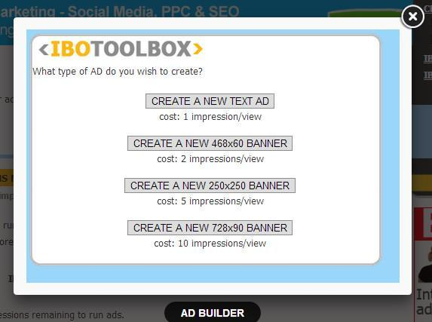
IBO Advertising
Ads are in various formats -
listing, banners, etc.
Banner ads come in three
sizes.
You will need to convert
credits to impressions in
the Credit Center to
run ads

Slide 17
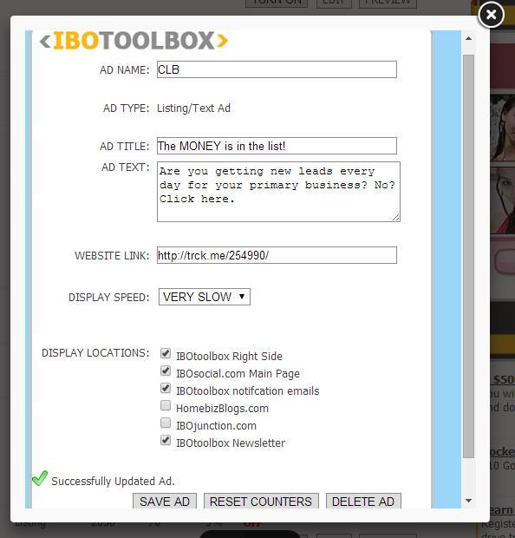
IBO Advertising
Create your listing -
if you want your credits to
last a long time, choose
‘very slow’ for display
speed

Slide 18
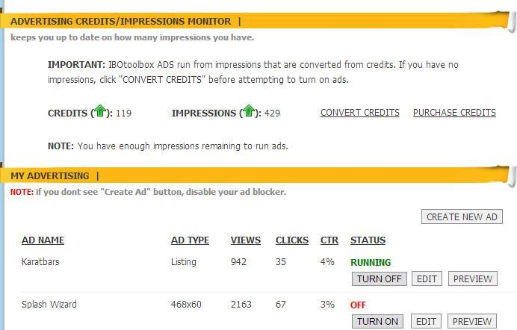
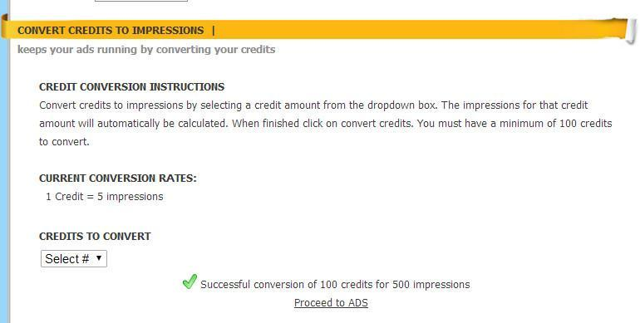
IBO Advertising
Convert your credits to impressions -
you need at least 100 to convert
Set your ads running

Slide 19
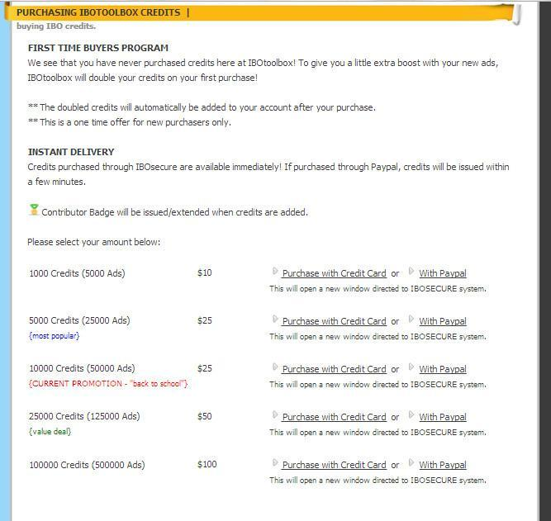
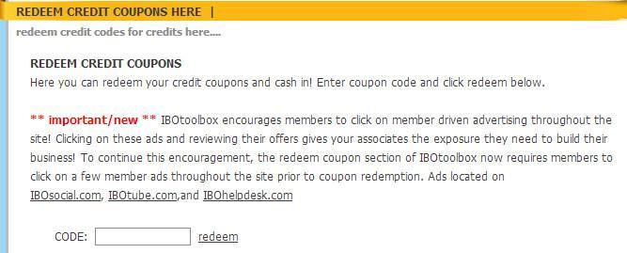
IBO Advertising - get more credits
You can also buy credits
IBO give you credit coupon codes
Twitter Tuesday
Facebook Thursday
Newsletter Sunday
Redeem a coupon on the credit page

Slide 20
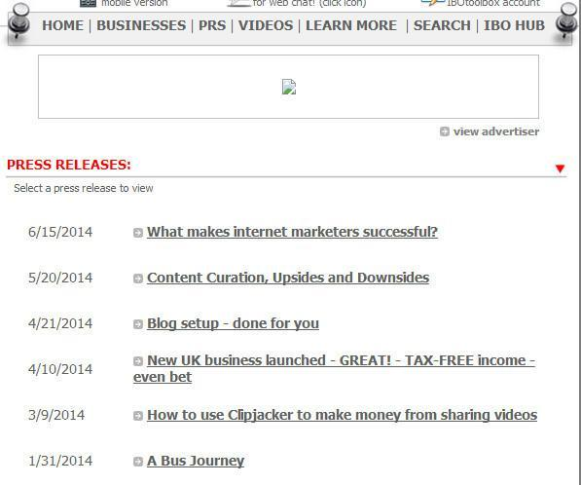
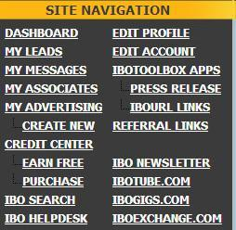
IBO Press Releases
On IBO an article or blog post is called a PR - they are listed on your
IBO Social Profile pages -
select the PR item from top menu to list yours or another member’s PRs -
select Press Releases on Toolbox menu to create a new one

Slide 21
IBO Toolbox - using video
As well as IBO Tube which is a separate video oriented site associated with
IBO Toolbox, you can embed video in your profile and in PRs.
Capture the embed code from YouTube and insert into your text using the HTML view.

Slide 22
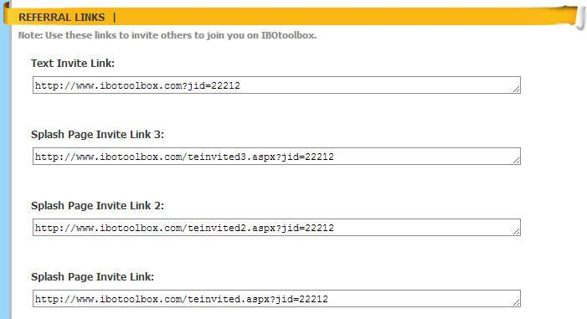
IBO Toolbox Referrals
As IBO is a free site,
you don’t get paid for
referrals but you DO
get advertising
credits!

Slide 23
IBO - wrapping it up
Use IBO Toolbox to :
Make new contacts
Promote your lead capture pages
Write articles about business topics
Run ads
This is a business oriented environment whereas Facebook started out as something for friends and family and then later got adopted by business networkers.
When you make a contact on Facebook, invite them to join IBO too

Slide 24
IBO Toolbox
Thank you for watching my presentation today
You can access a copy of this presentation in the Shared File Folder
There is further training material on IBO Toolbox and there are also weekly webinars

Slide 25
Where to Find us
Twitter #clblearning
www.FaceBook.com/ContactListBuilder
www.FaceBook.com/groups/contactlistbuilder/
Skype us: janetlegere or don.legere or tamra.trowbridge
www.ContactListBuilder.com/blog

